Slide 1
AMIT Graduation project
2021

Slide 2
Name : Omar Mohamed Hamza Email : Omar.mhamza98@gmail.com Group : Q10

Slide 3
Introduction:
Technology is the most common language in the world now and the human mindset prefers things to be automated, and the best place People can have this advantage is their homes , number of smart homes in massively increasing where people can control their home appliances and machines by their smart phones and this lead to save time and effort

Slide 4
Abstract:
This presentation will illustrate a simple smart home project where
The user can open and close room lamps

Slide 5
Methodology:
This project consist of two master and slave ECUs communicate with each other by SPI protocol and the master ECU communicate with the Bluetooth module (Virtual Terminal) by UART
in this project we use drivers that helps the code to be optimized and clean
Used drivers : (Std_Types, utilities, DIO, UART, SPI)

Slide 6
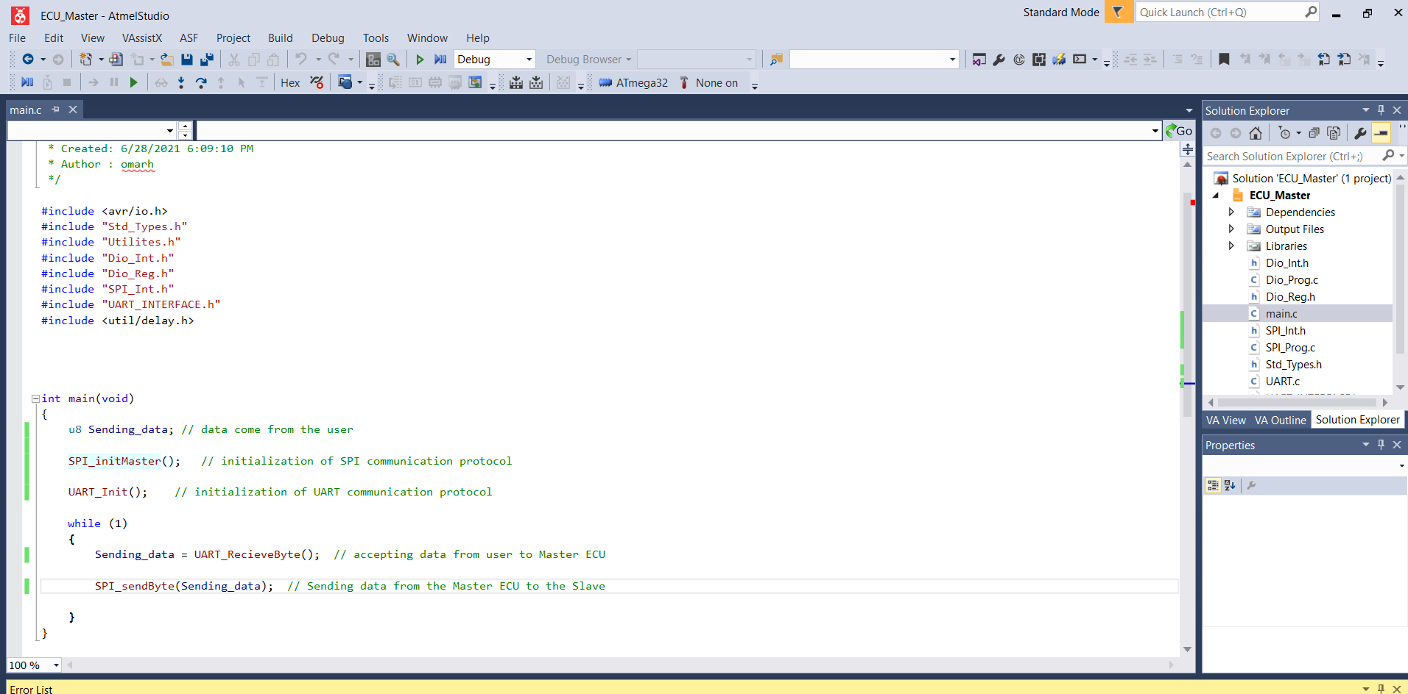
Master code
ECU Master code

Slide 7
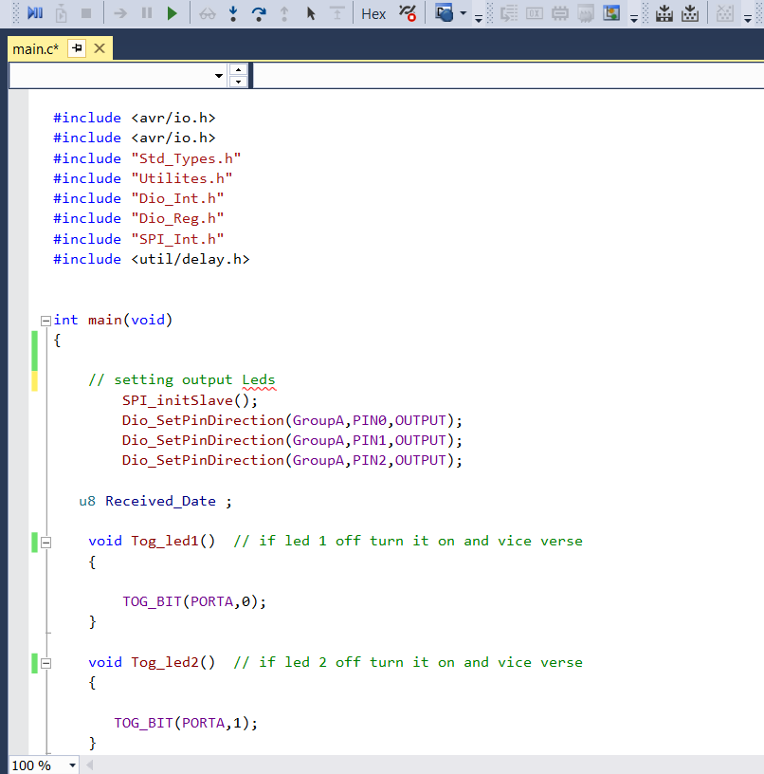
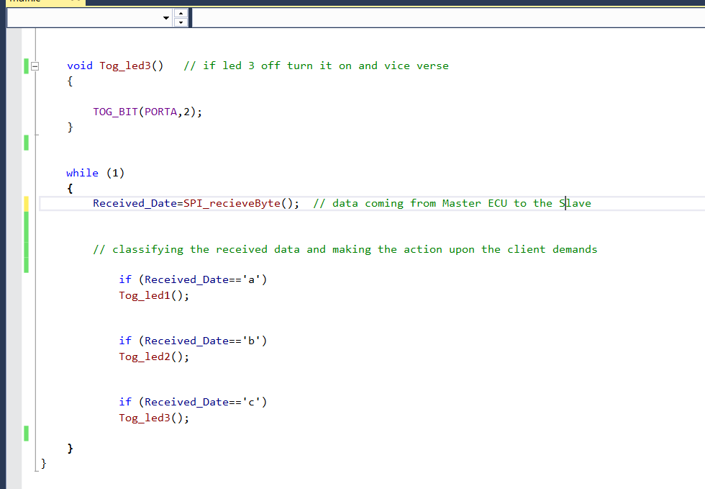
SLAVE CODE
ECU Slave code

Slide 8
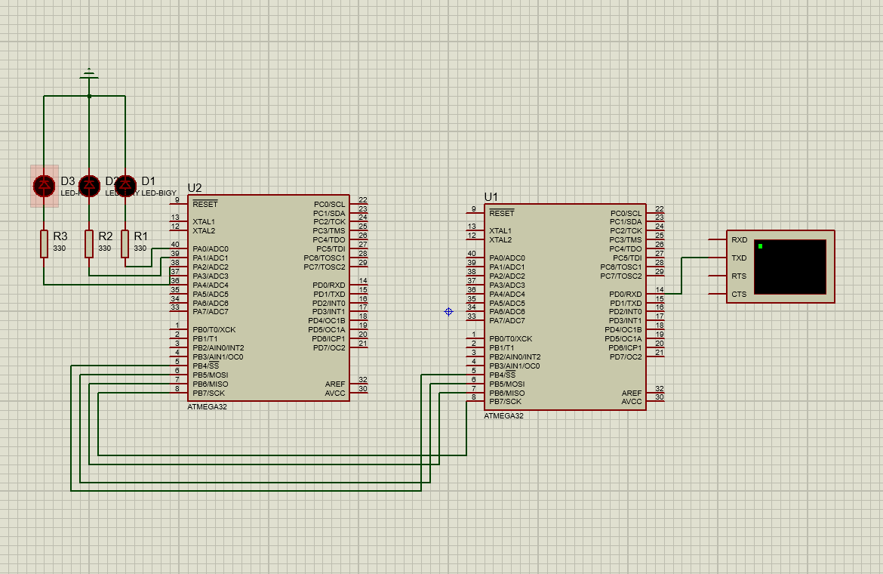
Simulation on proteus

Slide 9
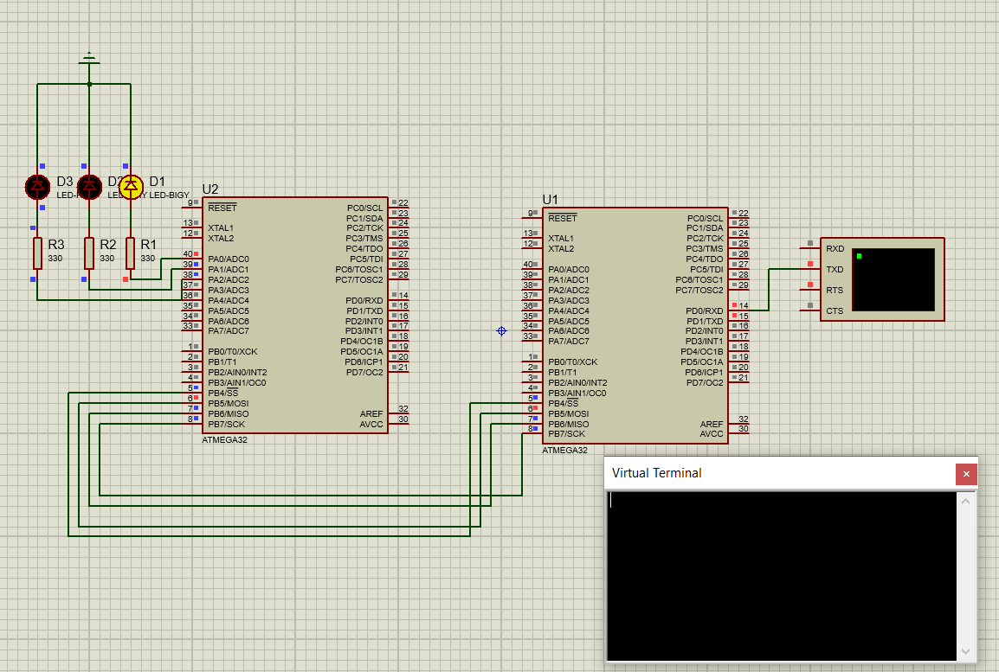
If user send ‘a’ led 1 turn on and off

Slide 10
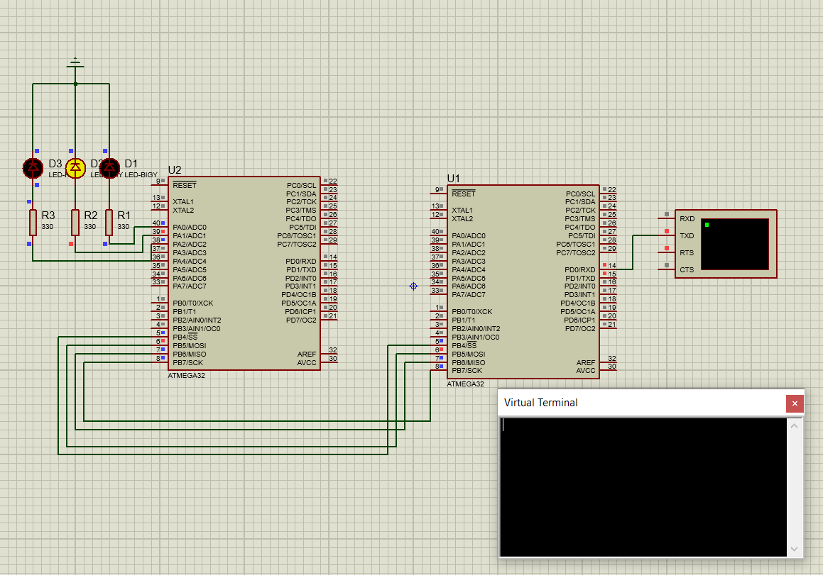
If user send ‘b’ led 2 turn on and off

Slide 11
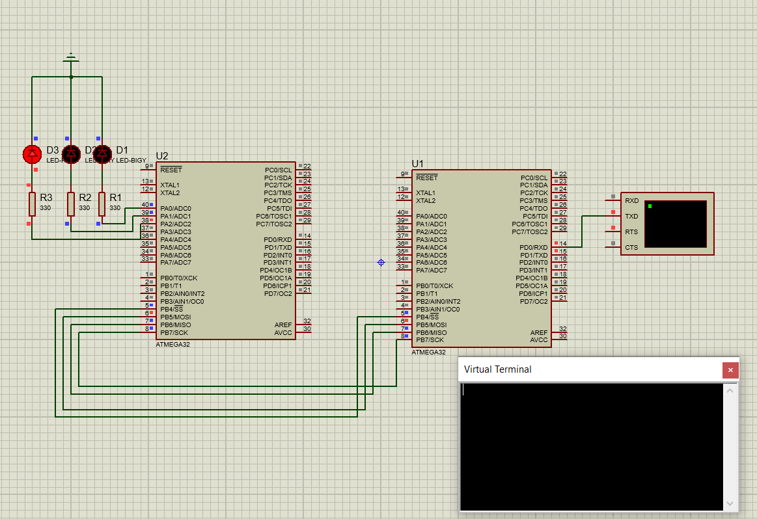
If user send ‘c’ led 3 turn on and off

